Slide 1






Detect Fake Accounts

Slide 2
USER
SYSTEM
PROJECT
IDEA
Sign In
Instagram API
The system will ask you to enter your email and password of your Instagram account
Using the sign in information from the user and apply them into Instagram API
Target
Model
Extract the data from the searched account and check the number of fake accounts on the following and the number of fake likes for post
The system will ask you to enter the account username that you want to checks.
Apply the extracted data from the API and clean them to the model
Show The Result
Calculation
After applying the model to target the result will appear to the user
Calculate the result and prepare it.

Slide 3
Preprocessing
Fake account
Use the data for extracting new features and remove useless features
Test the model on real account and check their following
1
2
3
4
5
Dataset
Modeling
Fake Likes
Extracting the dataset from csv file and use it clean it
Test multiple models and select the best one
Check likes of a post on the account and check the fake one
Detect Fake Accounts

Slide 4
null
Dataset
4
700
12
0
Record
Feature
Null
Detect Fake Accounts

Slide 5
No | profile pic | nums/length username | fullname words | nums/length fullname | name==username | description length | external URL
0 | 1 | 0.27 | 0 | 0.0 | 0 | 53 | 0
1 | 1 | 0.00 | 2 | 0.0 | 0 | 44 | 0
2 | 1 | 0.25 | 1 | 0.00 | 0 | 0 | 0
3 | 1 | 0.00 | 1 | 0.0 | 0 | 82 | 0
4 | 0 | 0.44 | 1 | 0.00 | 0 | 0 | 0
5 | 1 | 0.00 | 4 | 0.0 | 0 | 81 | 1
6 | 1 | 0.00 | 2 | 0.0 | 0 | 50 | 0
7 | 0 | 0.13 | 2 | 0.00 | 0 | 0 | 0
private | #posts | #followers | #follows | fake
0 | 32 | 1000 | 955 | 0
0 | 286 | 2740 | 533 | 0
1 | 102 | 39 | 229 | 1
0 | 679 | 414 | 651 | 0
0 | 4 | 17 | 20 | 1
0 | 344 | 669987 | 150 | 0
0 | 16 | 122 | 177 | 0
0 | 0 | 42 | 240 | 1
Detect Fake Accounts

Slide 6
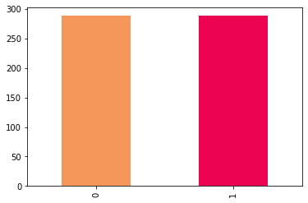
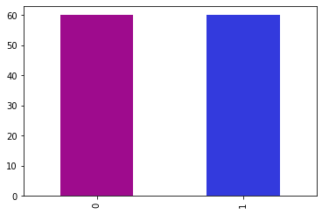
Balance Dataset
Testing
21%
Training
Testing
Training
79%
Detect Fake Accounts

Slide 7
Preprocessing
High_followers
In this step trying to add new features if possible and understanding the existing features.
High_follows
High_posts
Detect Fake Accounts

Slide 8
 | profile pic | nums/length username | fullname words | nums/length fullname | name==username | description length | external URL | private | #posts | #followers | #follows | fake
count | 700.000 | 700.000 | 700.000 | 700.000 | 700.000 | 700.000 | 700.000 | 700.000 | 700.000 | 700.000 | 700.000 | 700.000
mean | 0.758333 | 0.179917 | 1.550000 | 0.071333 | 0.041667 | 27.200000 | 0.100000 | 0.308333 | 82.866667 | 4.959472e+04 | 779.266667 | 0.500000
std | 0.429888 | 0.241492 | 1.187116 | 0.209429 | 0.200664 | 42.588632 | 0.301258 | 0.463741 | 230.468136 | 3.816126e+05 | 1409.383558 | 0.502096
min | 0.000000 | 0.000000 | 0.000000 | 0.000000 | 0.000000 | 0.000000 | 0.000000 | 0.000000 | 0.000000 | 0.000000e+00 | 1.000000 | 0.000000
25% | 1.000000 | 0.000000 | 1.000000 | 0.000000 | 0.000000 | 0.000000 | 0.000000 | 0.000000 | 1.000000 | 6.725000e+01 | 119.250000 | 0.000000
50% | 1.000000 | 0.000000 | 1.000000 | 0.000000 | 0.000000 | 0.000000 | 0.000000 | 0.000000 | 8.000000 | 2.165000e+02 | 354.500000 | 0.500000
75% | 1.000000 | 0.330000 | 2.000000 | 0.000000 | 0.000000 | 45.250000 | 0.000000 | 1.000000 | 58.250000 | 5.932500e+02 | 668.250000 | 1.000000
max | 1.000000 | 0.890000 | 9.000000 | 1.000000 | 1.000000 | 149.000000 | 1.000000 | 1.000000 | 1879.000000 | 4.021842e+06 | 7453.000000 | 1.000000
Detect Fake Accounts

Slide 9
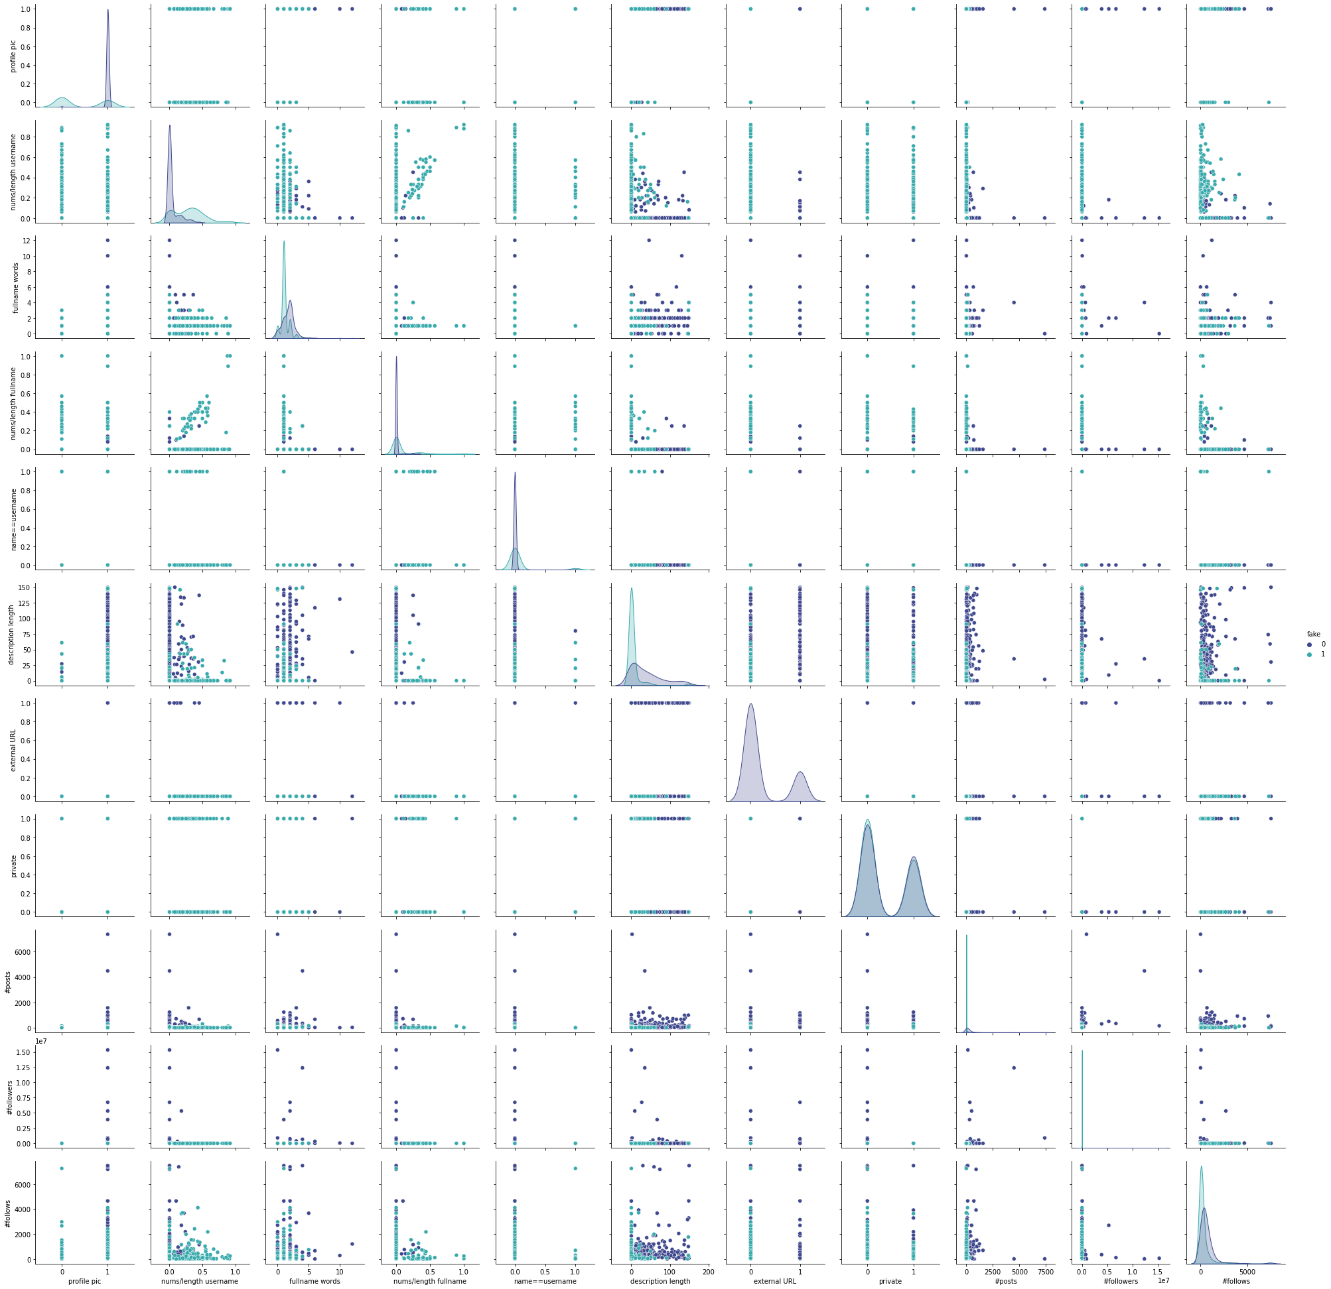
PAIRPLOT
VISUALIZE
The relationship between the features regarding on the fake feature which is specify as 1 or 0 where 1 means is fake and 0 otherwise, there are 121 chart once for each feature even for itself

Slide 10
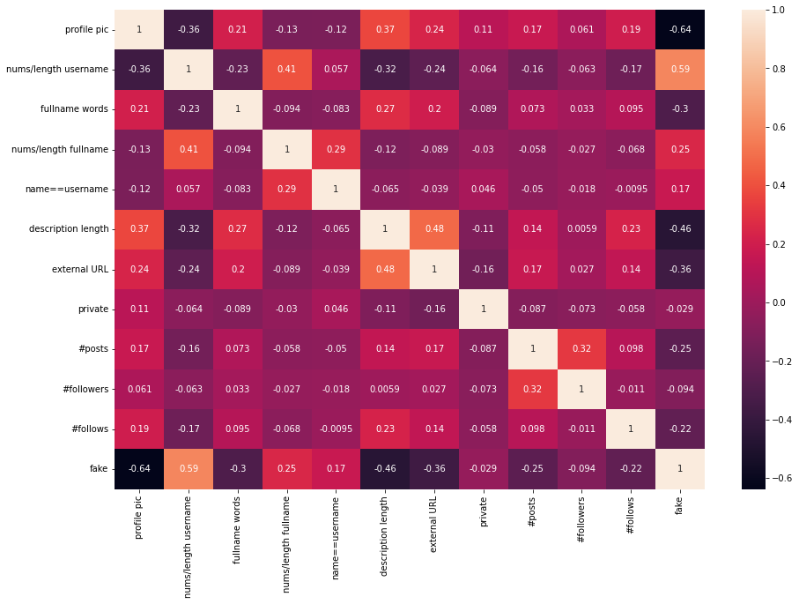
Feature | Value
fake | 1.000000
High_followers | 0.720319
High_posts | 0.680818
profile pic | 0.637315
nums/length username | 0.587687
High_follows | 0.476180
description length | 0.460825
external URL | 0.362809
fullname words | 0.298793
nums/length fullname | 0.246782
posts | 0.245355
follows | 0.224835
name==username | 0.170695
followers | 0.093689
private | 0.028586
Detect Fake Accounts

Slide 11
Modeling
Applying four different models to the dataset and select the highest results that fit the dataset. The models are:
1- Logistic Regression
2- KNN Classifier
3- Decision Tree Classifier
4- Random Forest Classifier

Slide 12
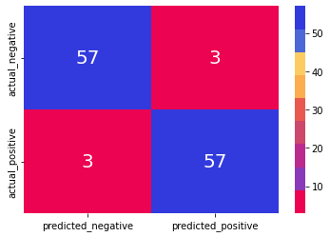
Logistic Regression
Confusion Matrix
Accuracy
Precision
Recall
F1-Score
0.95
0.95
0.95
0.95
Detect Fake Accounts

Slide 13
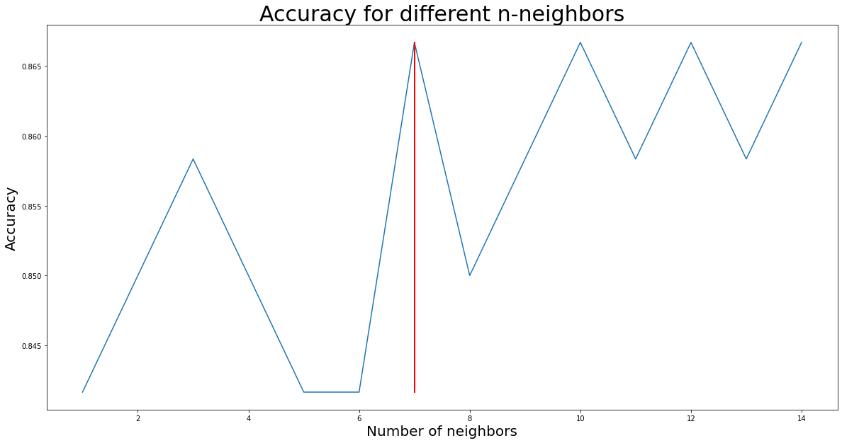
K Neighbors
Classifier
K Neighbors
7
Detect Fake Accounts

Slide 14
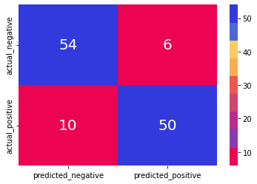
K Neighbors
Classifier
Confusion Matrix
Accuracy
Precision
Recall
F1-Score
0.867
0.834
0.893
0.862
Detect Fake Accounts

Slide 15

Decision Tree Classifier
Confusion Matrix
Accuracy
Precision
Recall
F1-Score
0.883
0.85
0.911
0.879
Social Network
Detect Fake Accounts
Analytics and Planning

Slide 16

Random
Forest
Classifier
Confusion Matrix
Accuracy
Precision
Recall
F1-Score
0.925
0.916
0.932
0.924
Detect Fake Accounts

Slide 17
Result
The best score is Logistic Regression with 95% Accuracy, which is the best model that fit the dataset according to the Confusion Matrix, F1-score, Recall and Precision.
Save Model
+178
The model has been saved and available in my Github repository as SAV file.
Social Network
Detect Fake Accounts
Analytics and Planning

Slide 18
Instagram API
Apply the model using the Instagram API, as the process that metioned earlier.

Slide 19
Sample
saThe account is: bnsabih
{'pk': 344073102, 'username': 'bnsabih', 'full_name': 'بن صبيح | BNSABIH', 'is_private': False, 'profile_pic_url': 'https://instagram.fruh4-6.fna.fbcdn.net/v/t51.2885-19/s150x150/186269661_297867151886843_2101231178066752495_n.jpg?_nc_ht=instagram.fruh4-6.fna.fbcdn.net&_nc_cat=111&_nc_ohc=JqFsVzBhroQAX-g31bP&edm=AEF8tYYBAAAA&ccb=7-4&oh=b7a0652ab79b0f9a4a7afd520dfd6ddd&oe=61967BC6&_nc_sid=a9513d', 'profile_pic_id': '2575631383133333808_344073102', 'is_verified': False, 'follow_friction_type': 0, 'has_anonymous_profile_picture': False, 'media_count': 166, 'geo_media_count': 0, 'follower_count': 1196, 'following_count': 567, 'following_tag_count': 0, 'biography': '"كُن قطعة فنية”🏺\n▪️𝗚𝗿𝗮𝗽𝗵𝗶𝗰 𝗗𝗲𝘀𝗶𝗴𝗻er | Freelancer 🇸🇦\n▫️Branding | Social Media Design\n▪️anasalsabih@gmail.com', 'biography_with_entities': {'raw_text': '"كُن قطعة فنية”🏺\n▪️𝗚𝗿𝗮𝗽𝗵𝗶𝗰 𝗗𝗲𝘀𝗶𝗴𝗻er | Freelancer 🇸🇦\n▫️Branding | Social Media Design\n▪️anasalsabih@gmail.com', 'entities': []},,
…
…
…
'smb_get_quote_partner': None, 'displayed_action_button_type': '', 'direct_messaging': False, 'open_external_url_with_in_app_browser': True}
Convert Data I
Converting the Map datatype by creating method that convert the needed data as table that meat the training needs and convert it to numerical representation.
Social Network
Detect Fake Accounts
Analytics and Planning

Slide 20
Convert Data II
List Sample
[[1, 0.42857142857142855, 1, 0.0, 0, 45, 0, 0, 3, 84, 787],
…
]
Dataframe Sample
profile pic | nums/length username | fullname words | nums/length fullname | name==username | description length | external URL | private | #posts | #followers | #follows | High_followers | High_follows | High_posts
1 | 0.428571 | 1 | 0.000000 | 0 | 45 | 0 | 0 | 3 | 84 | 787 | 0 | 1 | 0
Social Network
Detect Fake Accounts
Analytics and Planning

Slide 21


Selected Account
+60%
* Sample of 150 account
Detect Fake Accounts

Slide 22

Non-Fake Account
Sample
profile pic 1.0
nums/length username 0.0
fullname words 5.0
nums/length fullname 0.0
name==username 0.0
description length 109.0
external URL 1.0
private 0.0
#posts 37.0
#followers 8906.0
#follows 698.0
High_followers 1.0
High_follows 1.0
High_posts 1.0
The Model Predict
0
Which means the account is not fake
Detect Fake Accounts

Slide 23

Fake Account
Sample
profile pic 0.0
nums/length username 0.0
fullname words 1.0
nums/length fullname 0.0
name==username 1.0
description length 0.0
external URL 0.0
private 0.0
#posts 1.0
#followers 266.0
#follows 2305.0
High_followers 1.0
High_follows 1.0
High_posts 0.0
The Model Predict
1
Which means the account is fake
Social Network
Detect Fake Accounts
Analytics and Planning

Slide 24
Detect Fake Accounts
THANK YOU

